Slide 1
SBOL at Berkeley Labs (JGI, JBEI and ABF)
Ernst Oberortner
eoberortner@lbl.gov
SBOL @ IWBDA’19, Cambridge, UK
July 8th, 2019

Slide 2
SBOL-supporting CAD/CAM tools developed at
Operon Refactoring and Construction Assistant (ORCA)
Tasks: gene cluster refactoring (“Design”)
Availability: TBD
Publication: TBD
SBOL support: import and export of DNA sequences, provenance tracking of design tasks
Contact: Ernst Oberortner, eoberortner@lbl.gov
Build Optimization Software Tools (BOOST)
Tasks: sequence optimization for expression and synthesis (“Design”)
Availability: https://boost.jgi.doe.gov; contact ipo@lbl.gov for licensing information
Publication: Oberortner et al., ACS Synthetic Biology, 2017
SBOL support: import/export of DNA sequences, export of build instructions
Contact: Ernst Oberortner, eoberortner@lbl.gov
SynTrack
Tasks: Tracking the build process of synthetic DNA constructs
Availability: https://syntrack.jgi.doe.gov/; JGI internal use only
Publication: TBD
SBOL support: import of build instructions, export of performed build operations
Contact: Xianwei “John” Meng, xianweimeng@lbl.gov

Slide 3

SBOL-supporting CAD/CAM tools developed at
Inventory of Composable Elements (ICE)
Tasks: store DNA construct, source microbial strain/protein sequence info to EDD
Availability: https://public-registry.jbei.org; source code @ https://github.com/JBEI/ice
Publication: Ham et al., Nucleic Acids Research, 2012
SBOL support: import/export of DNA constructs
Contact: Hector Plahar, haplahar@lbl.gov
Experimental Data Depot (EDD)
Tasks: store experimental data (”Test”), source strain/protein/Test data to ML algorithms
Availability: https://public-edd.jbei.org; source code @ https://github.com/JBEI/edd
Publication: Morrell et al., ACS Synthetic Biology, 2017
SBOL support: TBD
Contact: William Morrell, wcmorrell@lbl.gov

Slide 4

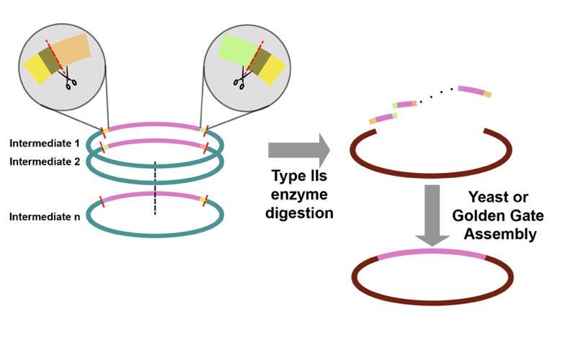

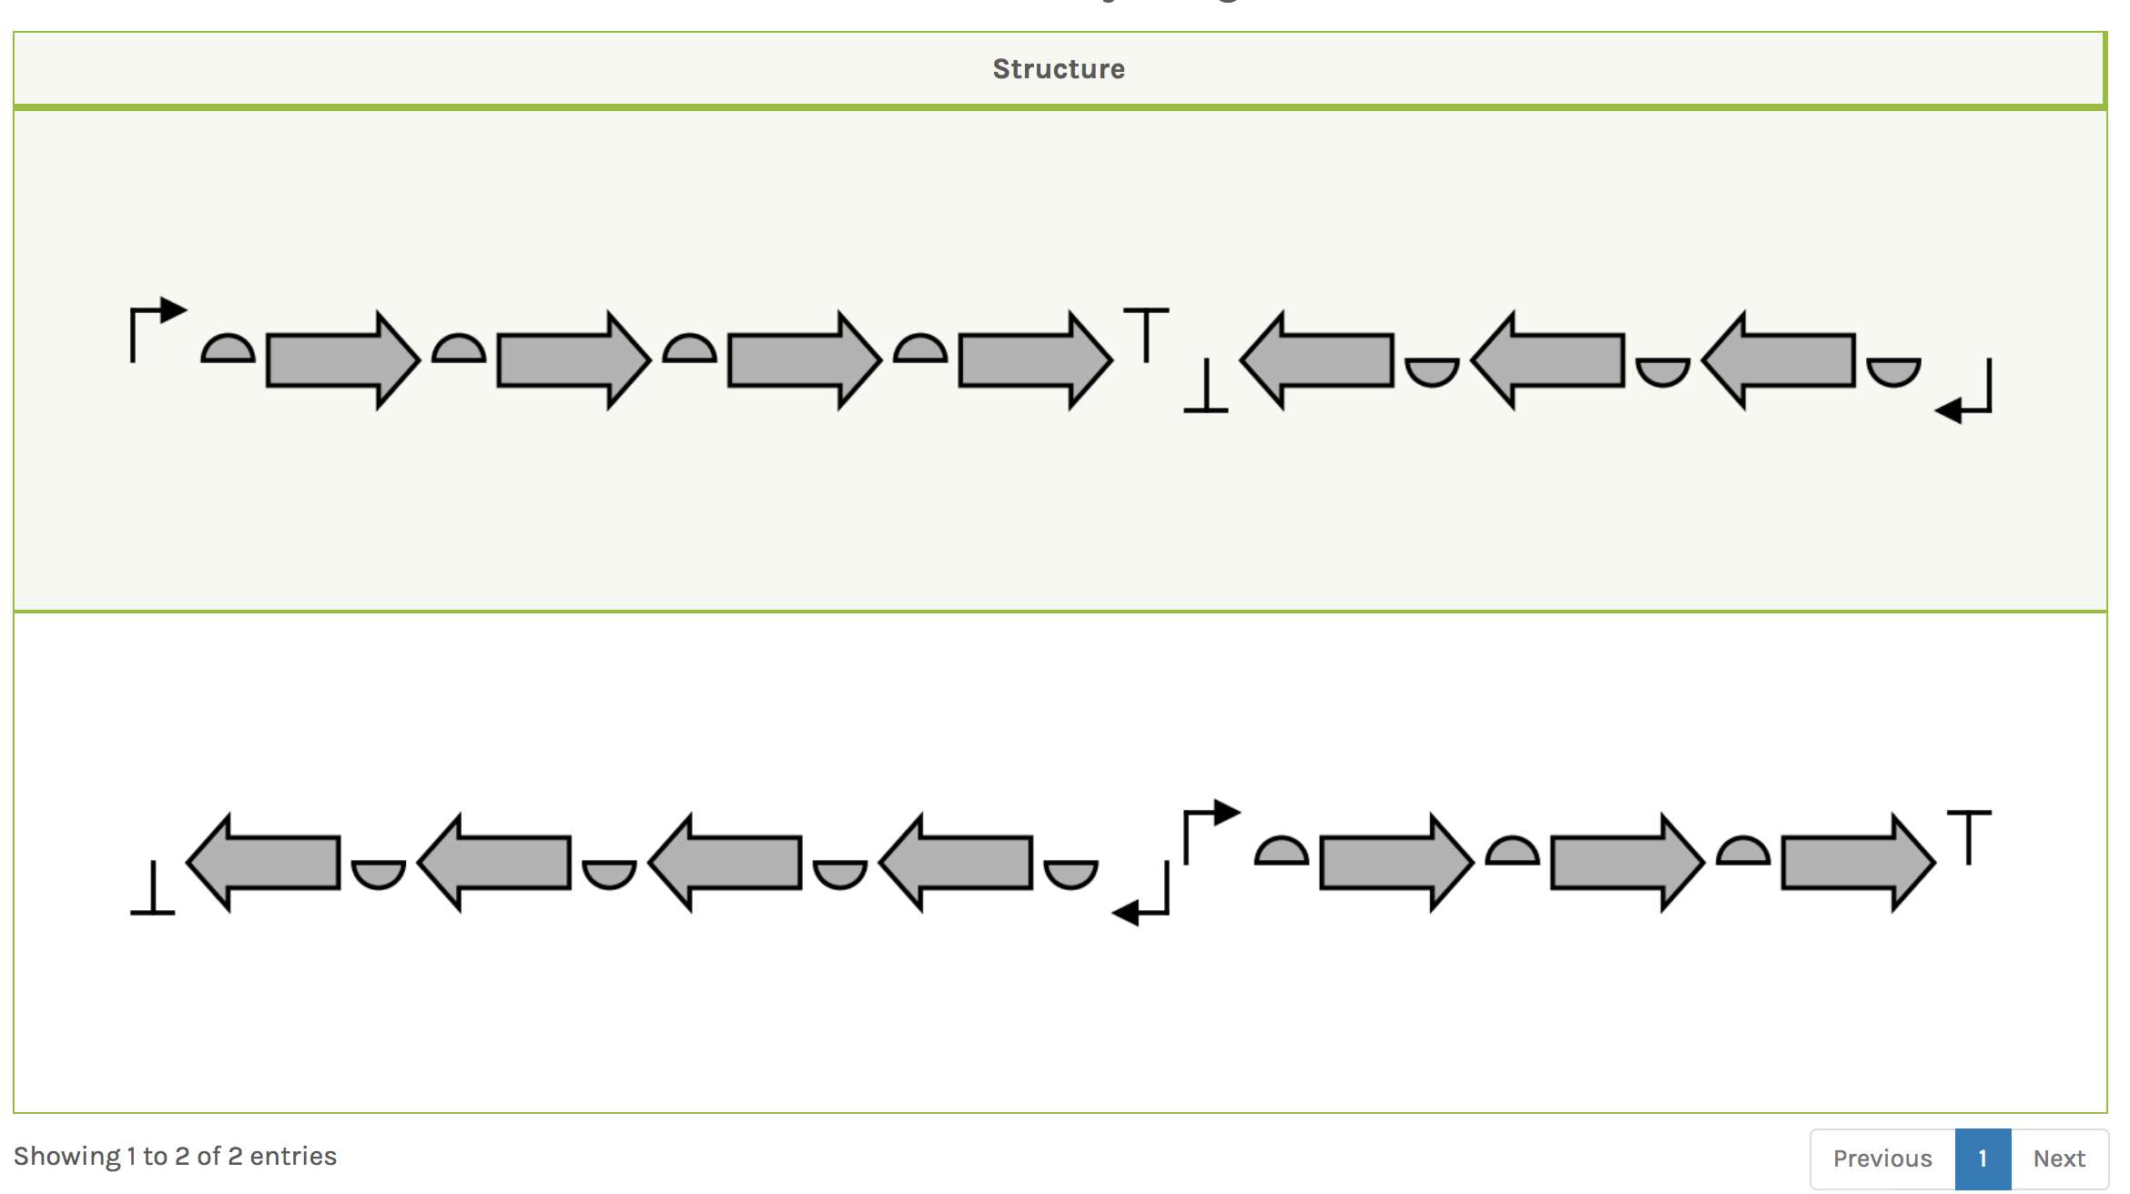
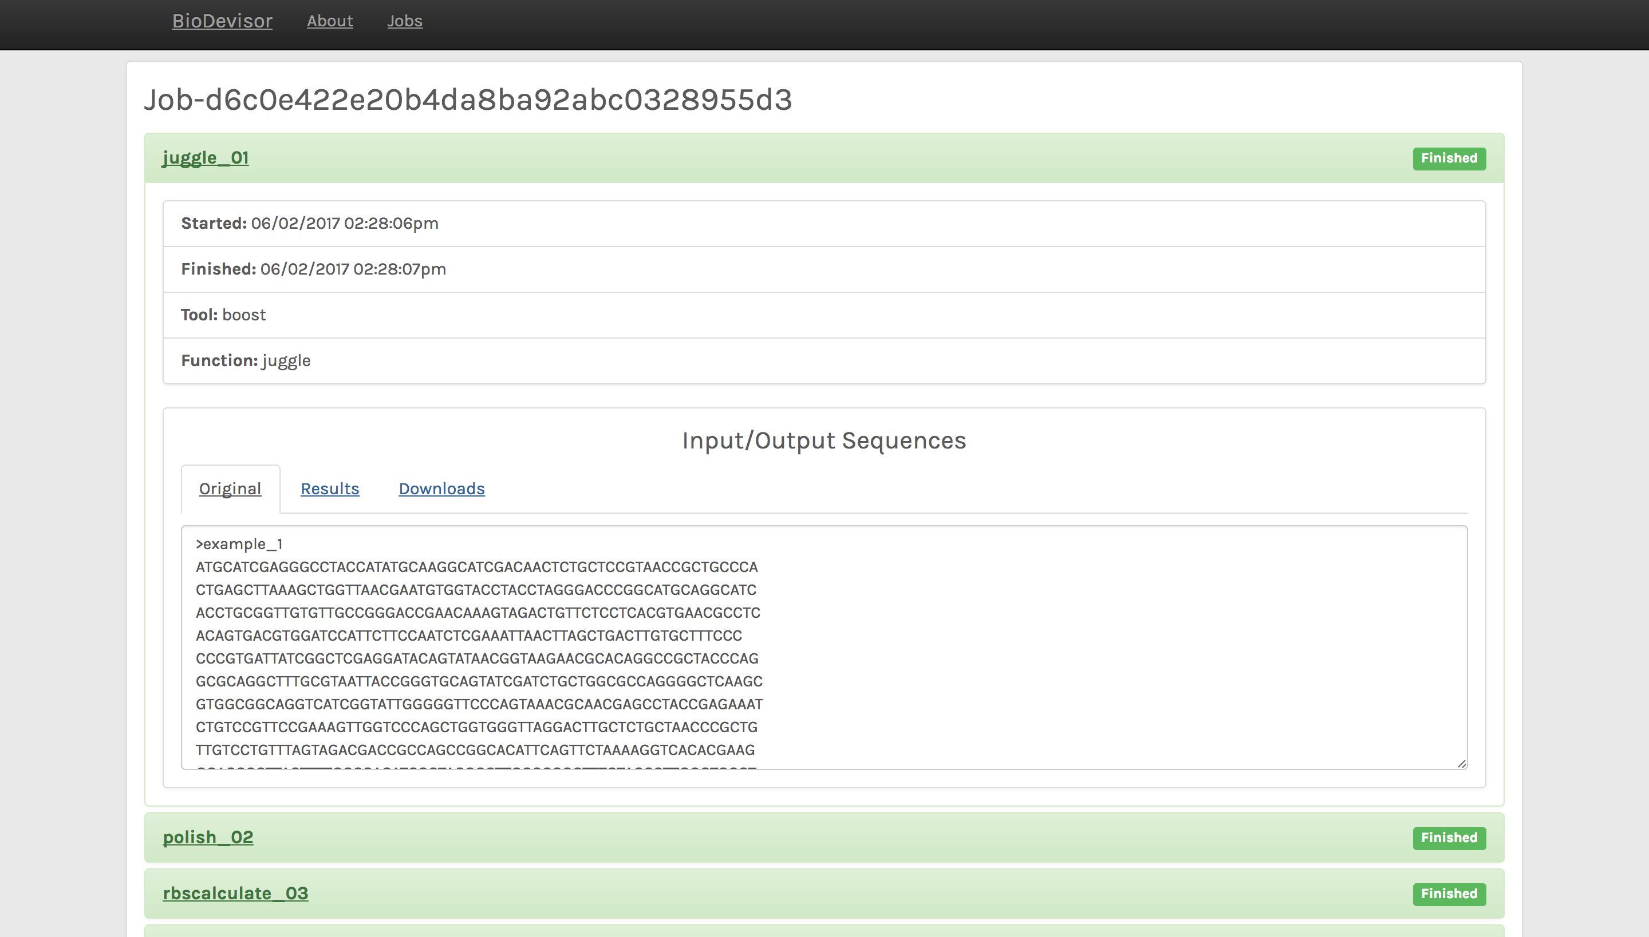
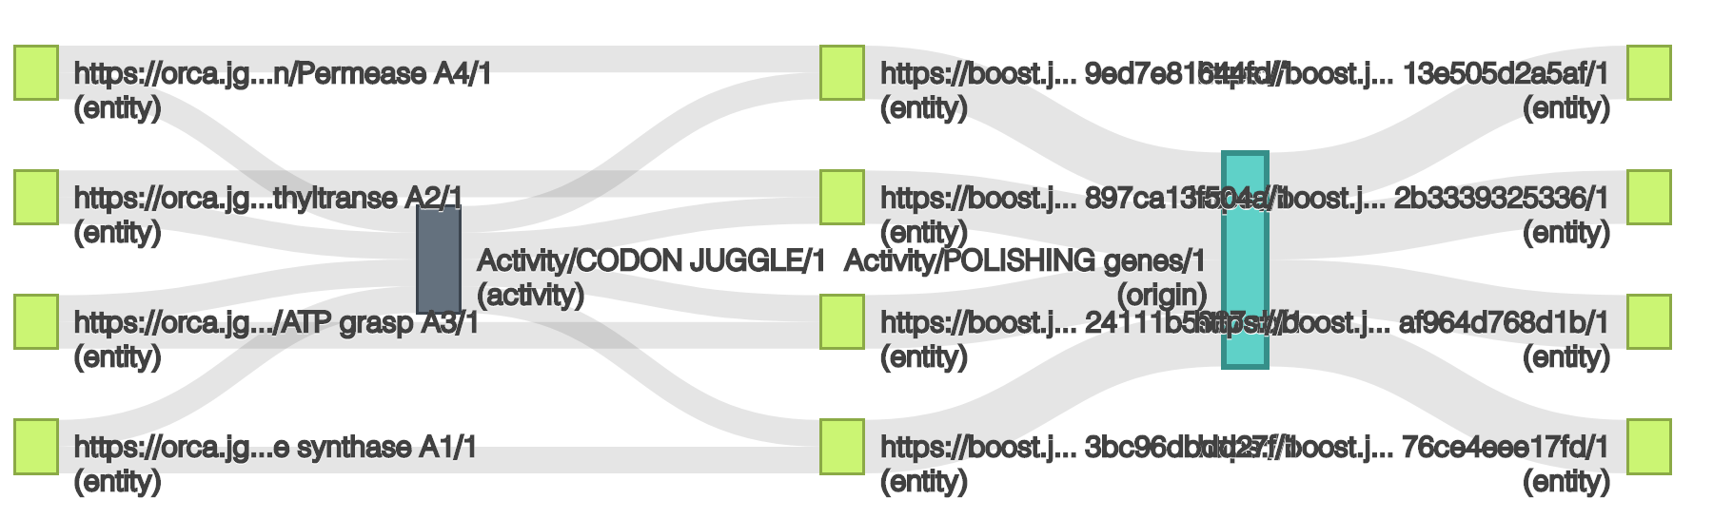
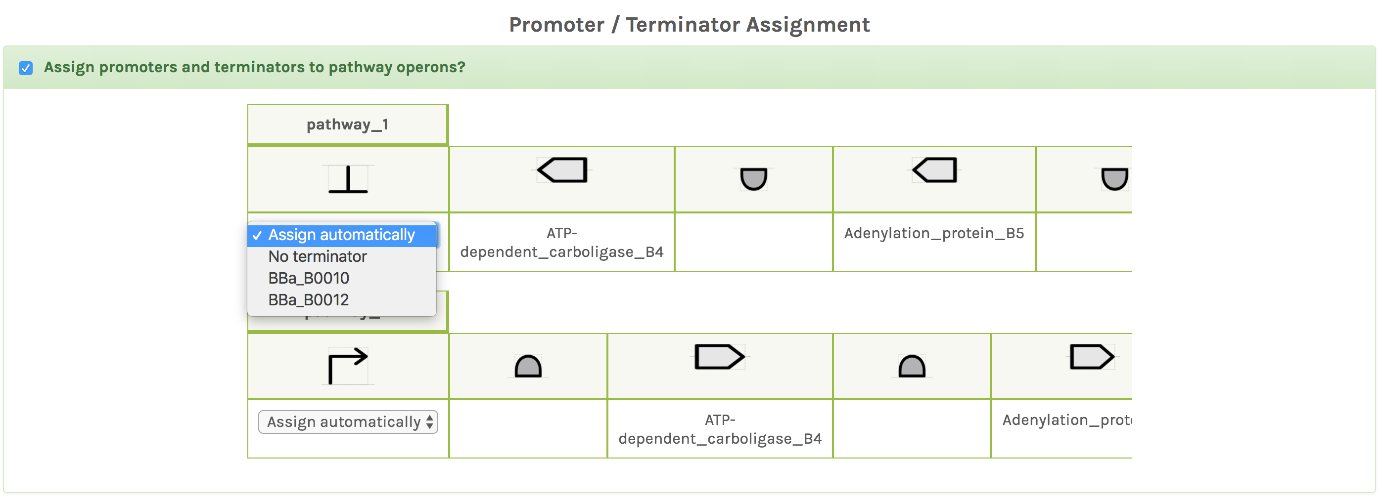
ORCA streamlines gene cluster refactoring including provenance tracking
Product Type
Pathway or multiple operons
ORCA
Operon Refactoring and Construction Assistant
Design of pathway/operon structures
Integration of RBS calculators
https://boost.jgi.doe.gov
Reverse-Translation & Codon-Optimization
Preparation for DNA Synthesis and Assembly
Assembly/Cloning Instructions
Streamlined
design process
Output of
synthetic DNA
Tracking of
design activities
http://provoviz.org/

Slide 5
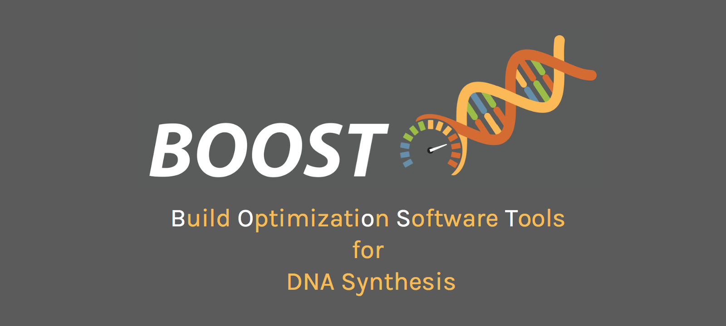

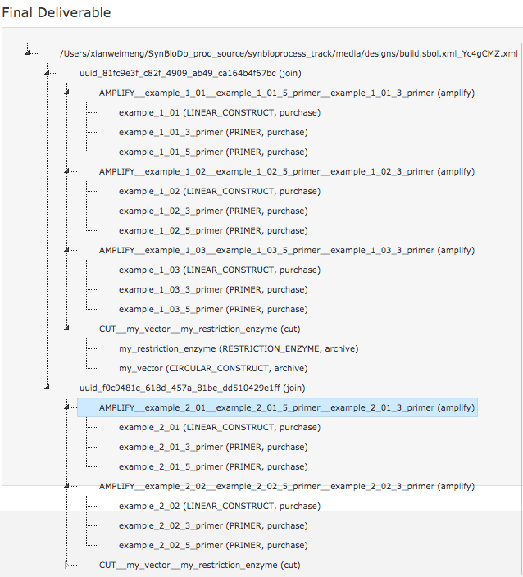
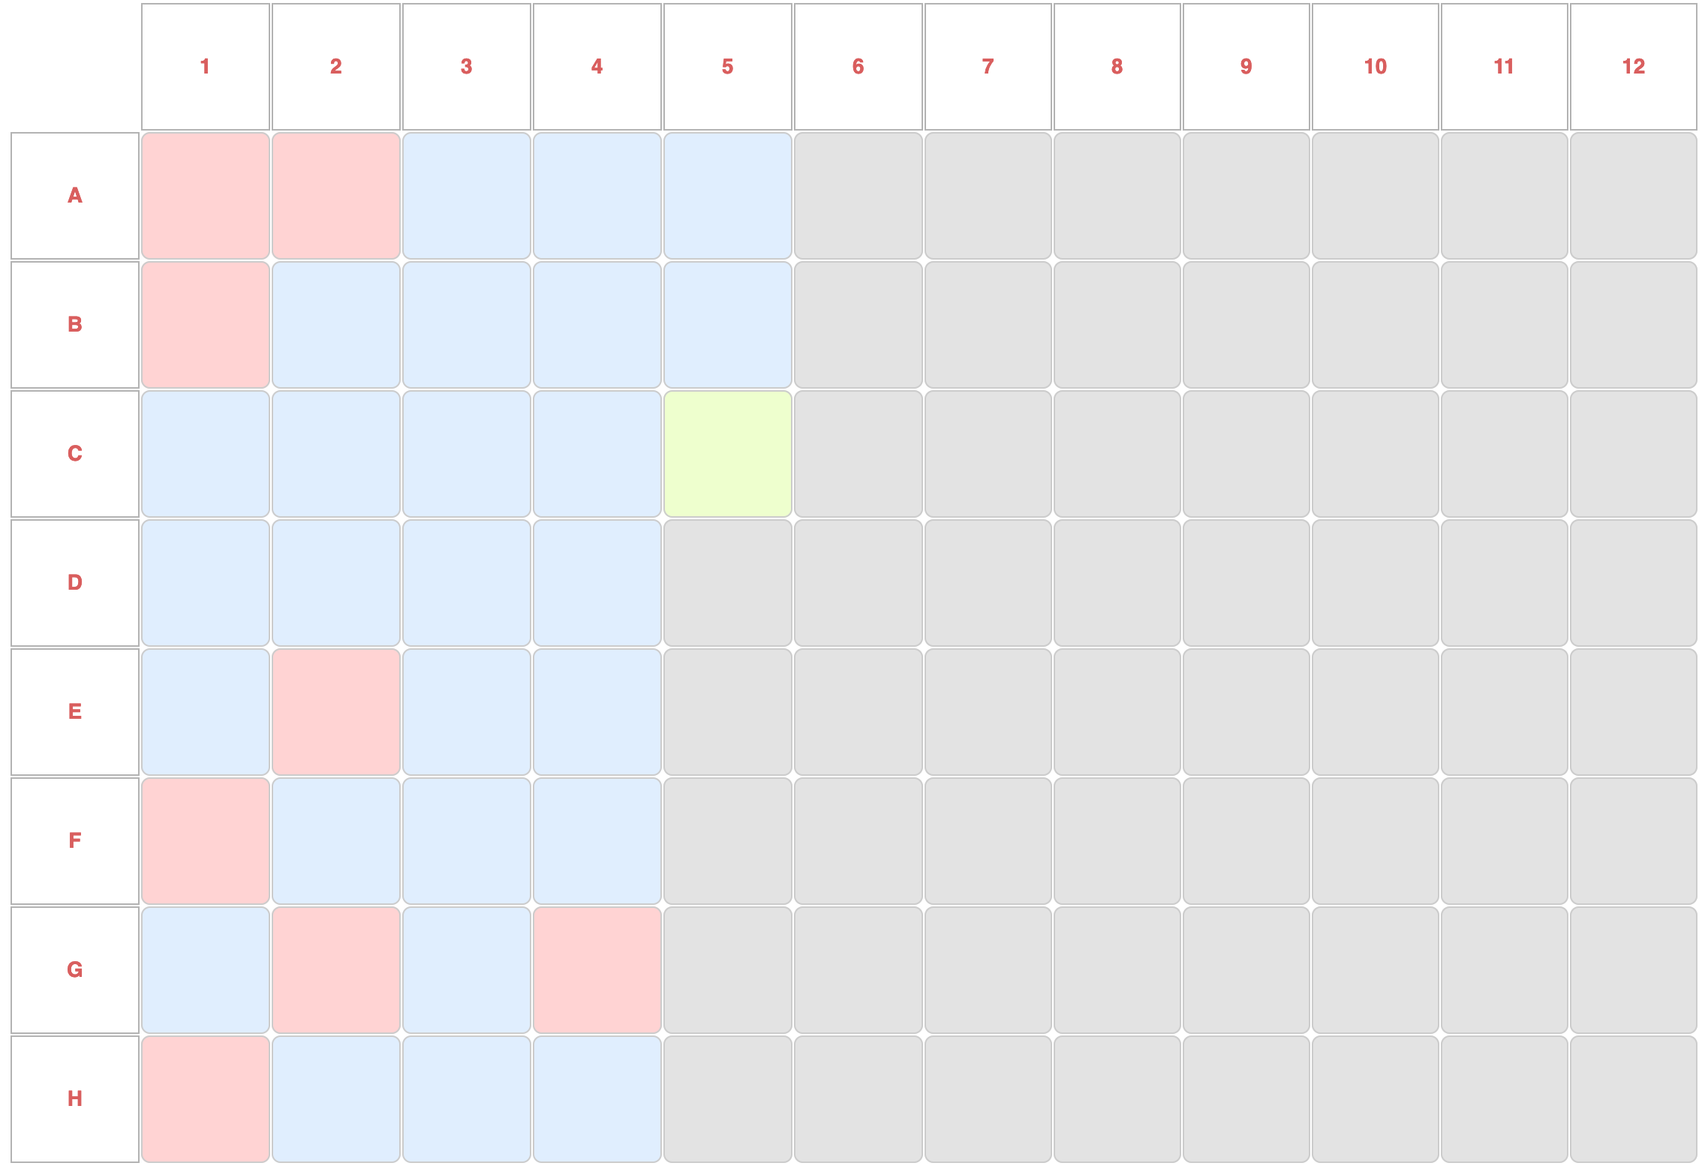
build.sbol encodes instructions for building synthetic DNA constructs
Design
join (
cut ( my_vector, restriction_enzyme ),
amplify ( fragment1,
fragment1_5primer, fragment1_3primer) )
https://bitbucket.org/berkeleylab/build.sbol
Build
SynTrack
1. Import of Build.SBOL
2. Execute and Track
3. Export
Inventory Management:
check inventory
retrieve from inventory
purchase
Lab Activities:
transform clones
pick colony
verify QC
verify worklist output
Robot Instructions:
generate worklist
execute protocol
Plate Management:
rearray/merge/split plate
condense/expand plate
Master plate
for each well on master plate:
status
provenance

Slide 6
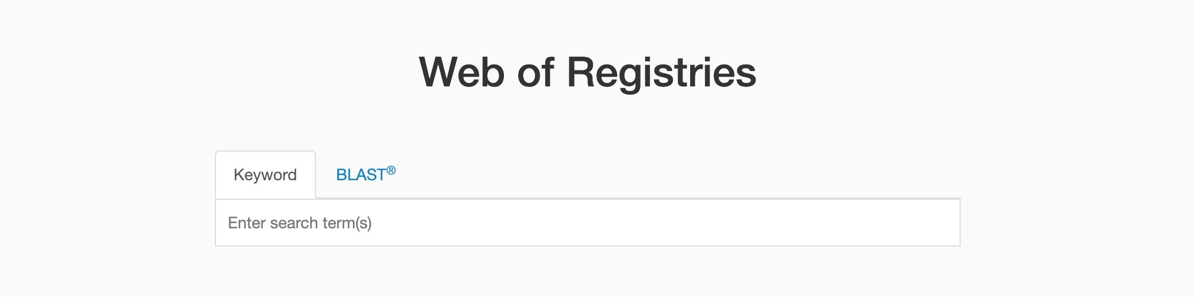
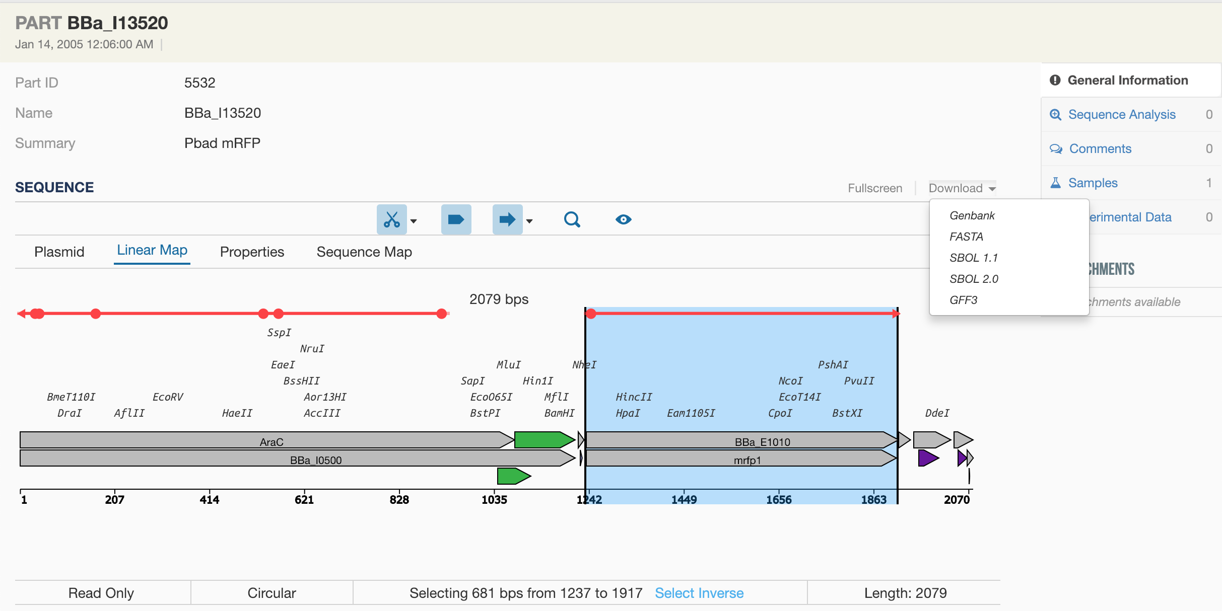
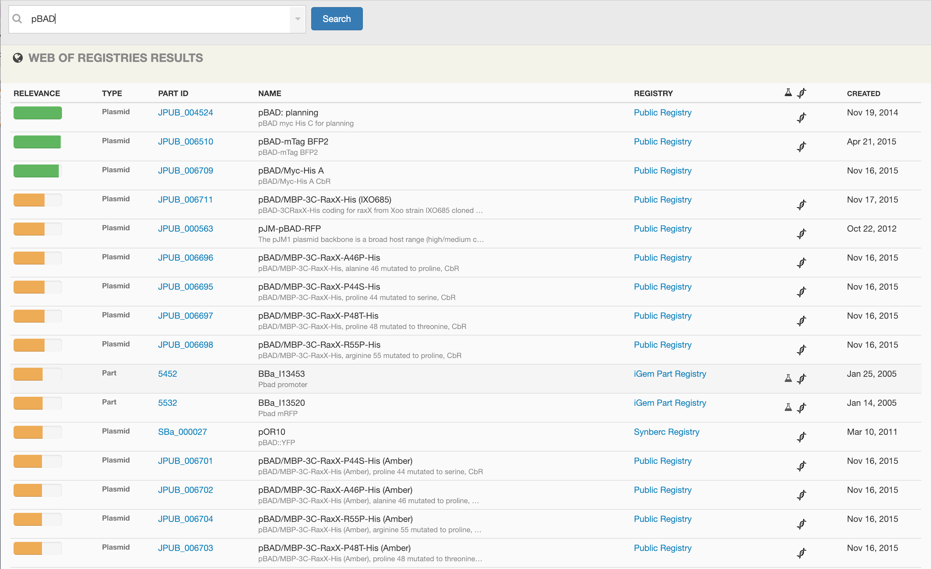
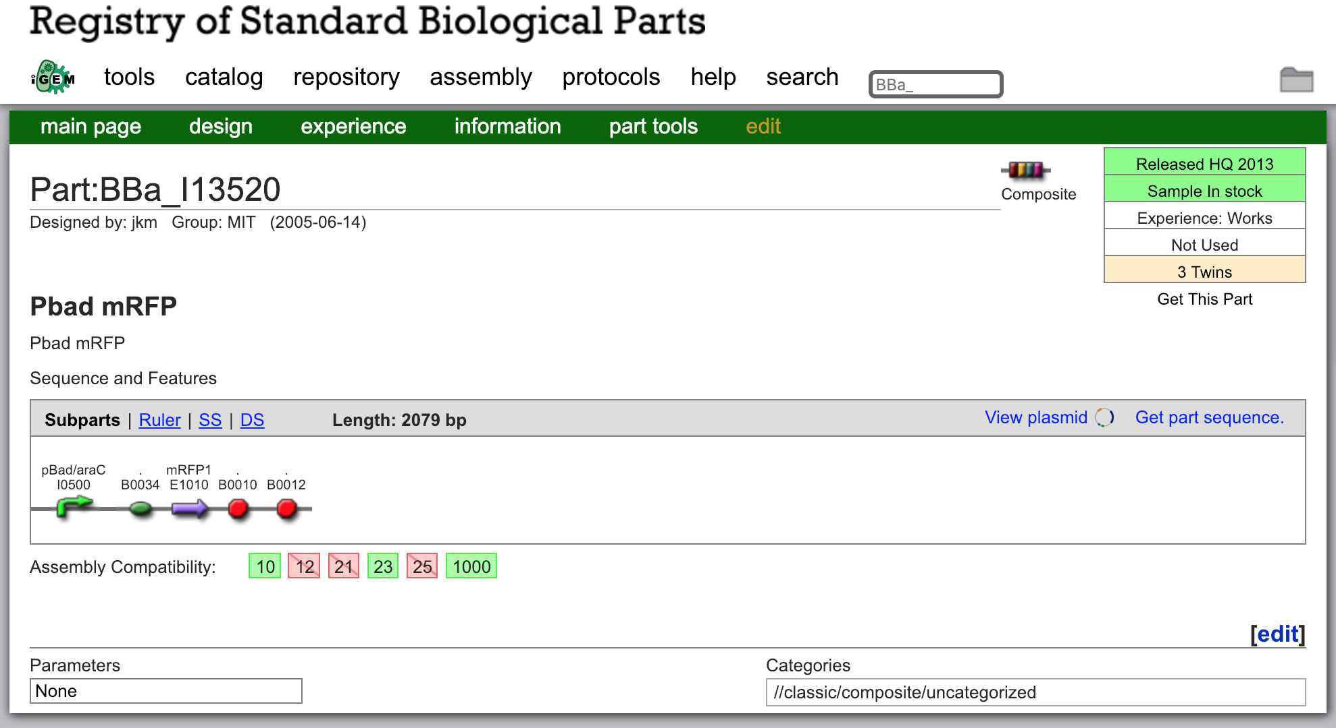
ICE and its search portal implement the “Web of Registries” concept
The “Web of Registries” concept aims to accelerate and broaden the distribution and discovery of biological parts data for biotechnology research applications.
search for publicly accessible
biological part information
View more detailed information
about parts
1
3
https://www.webofregistries.org
search results showing parts
from different sources
2
Visualization using
https://github.com/TeselaGen/openVectorEditor
Statistics:
20 public and private ICE instances deployed
Web of Registries sources: ICE, Addgene, iGEM, NCBI
7 public ICE instances participate in Web of Registries
“Remote Source”
https://parts.igem.org
Notes:
Ideal: SynBioHub instances in web of registries
Needed: standardized API

Slide 7
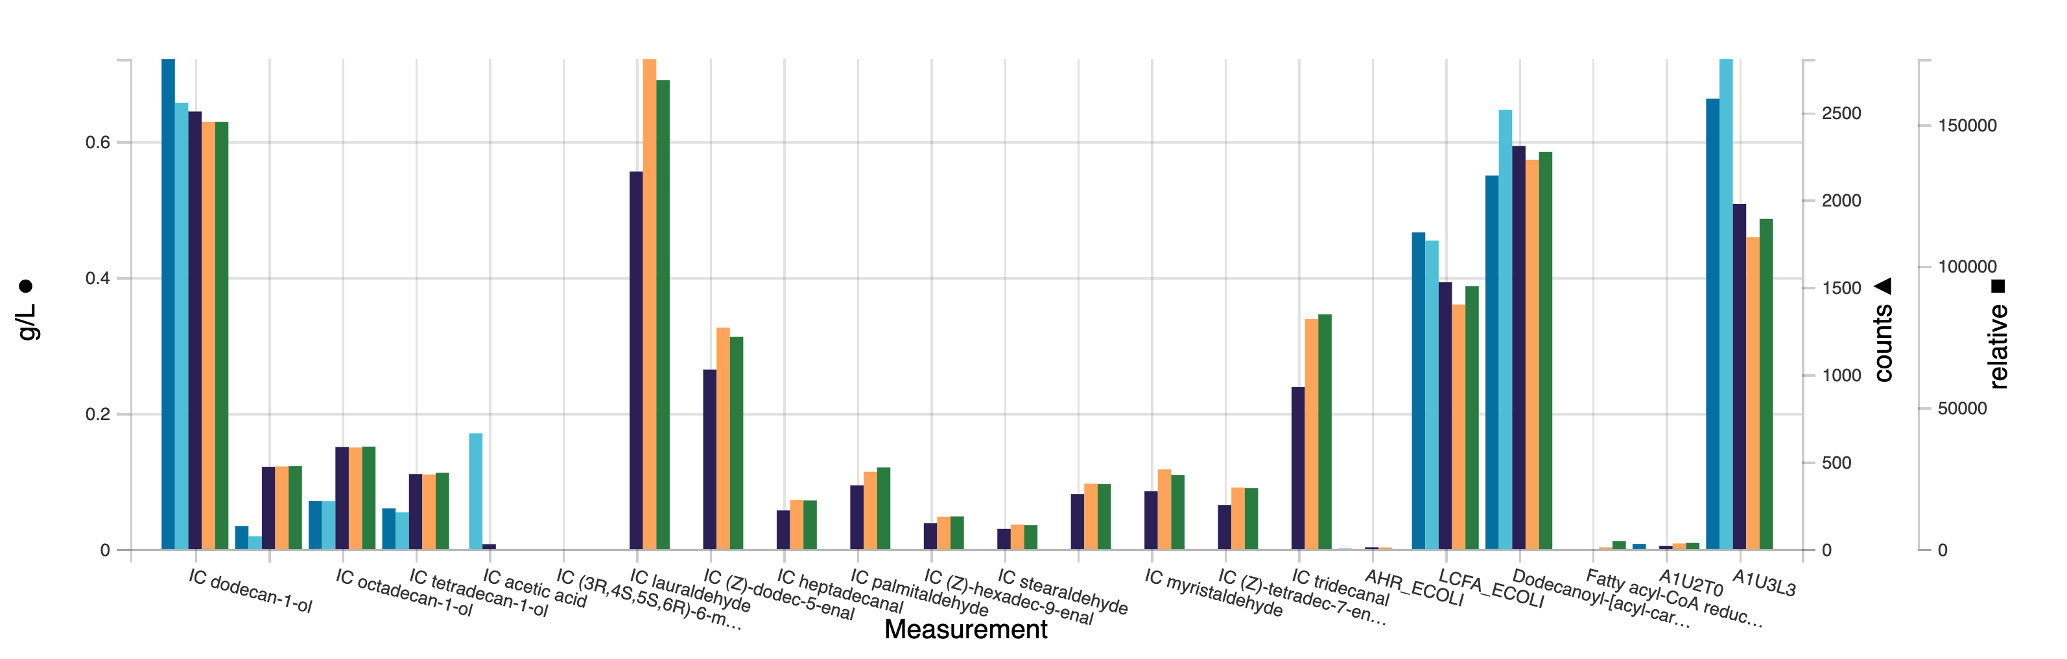
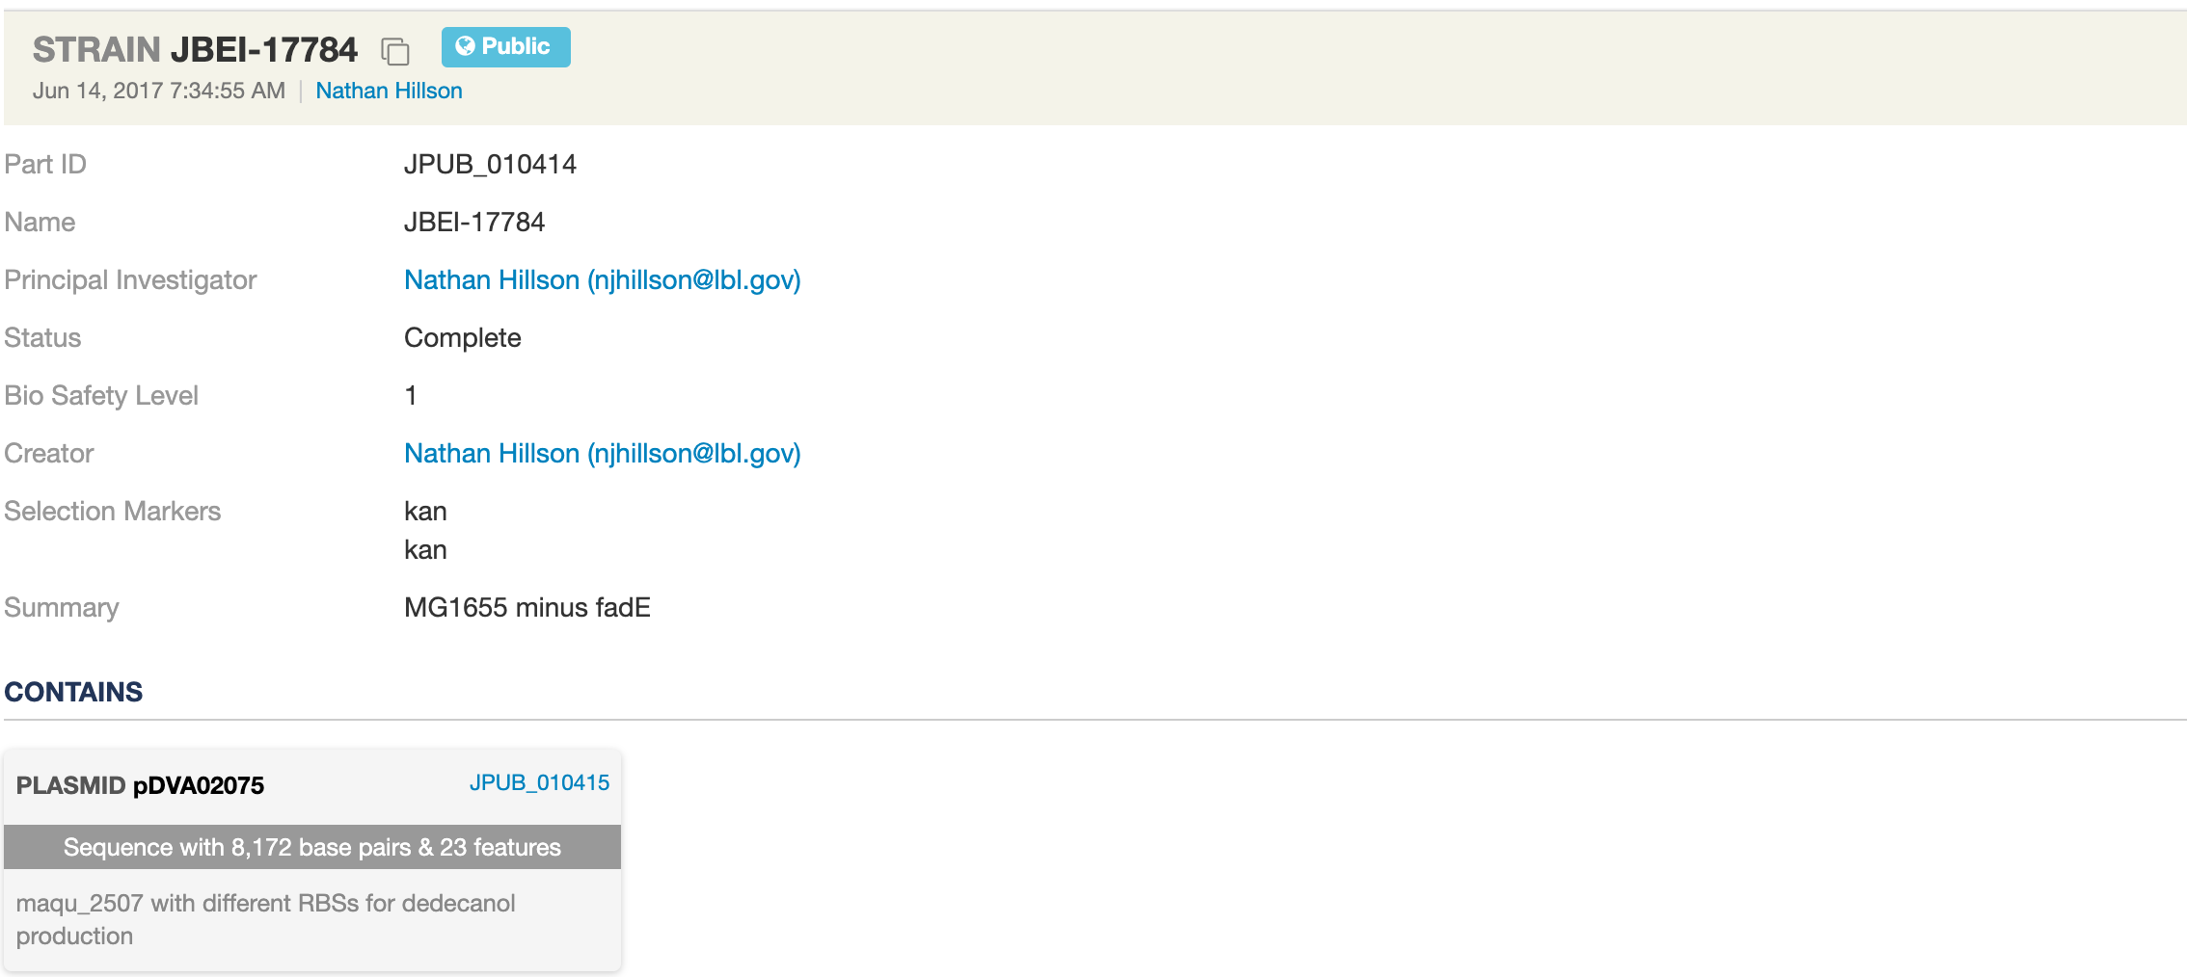
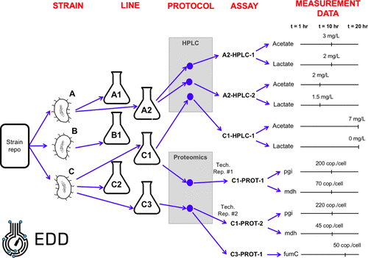
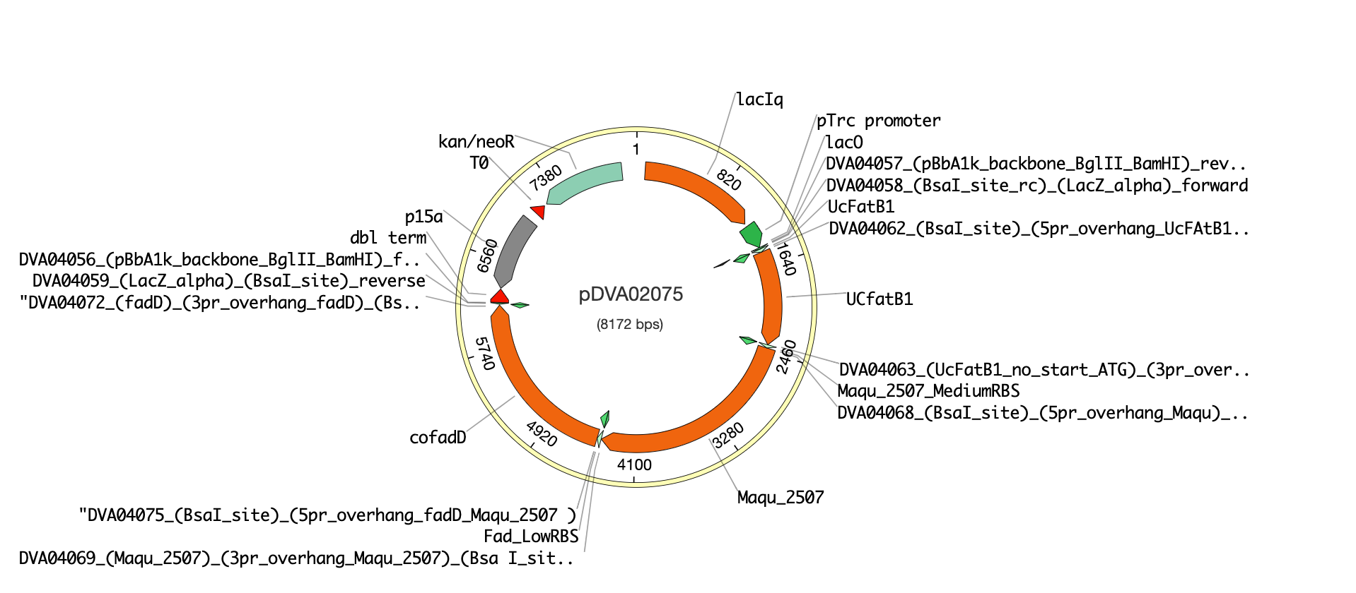
EDD is a repository for biologically interpretable (“actionable”) data
https://public-edd.jbei.org/
List of characterized strains
Data Visualization
https://public-registry.jbei.org
EDD’s Ontology
Visualization using
https://github.com/TeselaGen/openVectorEditor
Statistics:
4 EDD instances deployed
>100 “Test” datasets
proteomics, metabolomics, transcriptomics, flow-cytometry
Notes:
SBOL – TEST ontology → should be compatible w/ EDD’s ontology (add bullet point to slide)

Slide 8

Ernst Oberortner
eoberortner@lbl.gov

